Slide 1

OS Structures
Computer System Engineering, Fall 2018. (IPADS, SJTU)
Monolithic kernel, Micro-kernel, Virtual Machine
Yubin Xia

Slide 2
Review: send() with Lock
send(bb, msg):
acquire(bb.lock)
while True:
if bb.in – bb.out < N:
bb.buf[bb.in mod N] <- msg
bb.in <- bb.in + 1
release(bb.lock)
return
send(bb, msg):
acquire(bb.lock)
while True:
if bb.in - bb.out < N:
bb.buf[bb.in mod N] <- msg
bb.in <- bb.in + 1
release(bb.lock)
return
release(bb.lock)
yield()
acquire(bb.lock)
Problem: still spend lots of time on useless checking

Slide 3
Review: Send with WAIT/NOTIFY (Incorrect Version)
send(bb, msg):
acquire(bb.lock)
while True:
if bb.in - bb.out < N:
bb.buf[bb.in mod N] <- msg
bb.in <- bb.in + 1
release(bb.lock)
return
release(bb.lock)
yield()
acquire(bb.lock)
send(bb, msg):
acquire(bb.lock)
while True:
if bb.in - bb.out < N:
bb.buf[bb.in mod N] <- msg
bb.in <- bb.in + 1
release(bb.lock)
notify(bb.not_empty)
return
release(bb.lock)
wait(bb.not_full)
acquire(bb.lock)
wait() will call yield()
Problem: notification may lost, wait() forever

Slide 4
Review: WAIT(bb.full, bb.lock)
send(bb, msg):
acquire(bb.lock)
while True:
if bb.in - bb.out < N:
bb.buf[bb.in mod N] <- msg
bb.in <- bb.in + 1
release(bb.lock)
notify(bb.not_empty)
return
release(bb.lock)
wait(bb.not_full)
acquire(bb.lock)
send(bb, msg):
acquire(bb.lock)
while True:
if bb.in - bb.out < N:
bb.buf[bb.in mod N] <- msg
bb.in <- bb.in + 1
release(bb.lock)
notify(bb.not_empty)
return
release(bb.lock)
wait(bb.not_full)
acquire(bb.lock)
wait(bb.not_full, bb.lock)

Slide 5
Review: YIELD_WAIT()
yield_wait(): // called by wait()
id = cpus[CPU].thread
cpus[CPU].thread = null
threads[id].sp = SP
SP = cpus[CPU].stack
do:
id = (id + 1) mod N
release(t_lock)
enable_interrupt()
disable_interrupt()
acquire(t_lock)
while threads[id].state != RUNNABLE
SP = threads[id].sp
threads[id].state = RUNNING
cpus[CPU].thread = id
wait(cv, lock):
disable_interrupt()
acquire(t_lock)
release(lock)
threads[id].cv = cv
threads[id].state = WAITING
yield_wait()
release(t_lock)
enable_interrupt()
acquire(lock)
Notes:
Why introducing cpus[] to maintain per-cpu stacks?
Why no lock for cpus[]?
Why release(t_lock) and acquire again in the while loop in yield_wait()?
Why disable and enable interrupt?

Slide 6
Eventcount & Sequencer

Slide 7
Step-1: 4 Primitives
AWAIT (eventcount, value)
ADVANCE (eventcount)

Slide 8
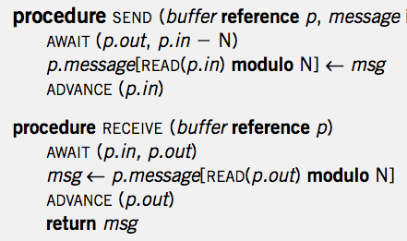
Single Sender and Single Receiver

Slide 9
Step-2: 4 Primitives
AWAIT (eventcount, value)
ADVANCE (eventcount)
TICKET (sequencer)
READ (eventcount or sequencer)

Slide 10
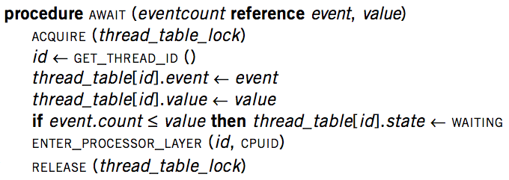
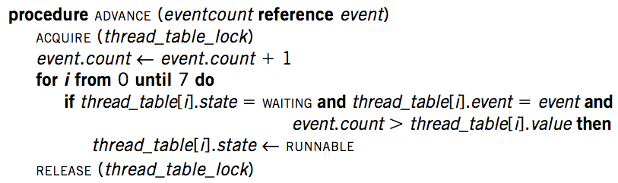
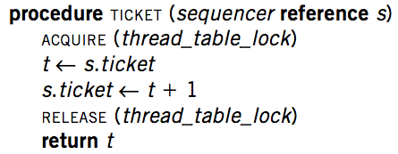
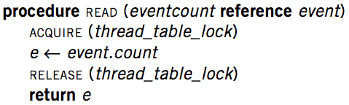
Implementation

Slide 11
AWAIT
A difference: it has a state: event and value, which can be used to determine whether the thread should keep waiting or awake

Slide 12
Primitives for Sequence Coordination
AWAIT (eventcount, value) is a before-or-after action
Compares eventcount to value
If eventcount exceeds value
AWAIT returns to its caller
If eventcount is less than or equal to value
Changes the state of the calling thread to WAITING
Places value and the name of eventcount in this thread’s entry in the thread table
Yields its processor

Slide 13
ADVANCE
Does it have the “lost notification” problem?
No, since the AWAIT and ADVANCE are synced by the thread_table_lock

Slide 14
Primitives for Sequence Coordination
ADVANCE (eventcount) is a before-or-after action
Increments eventcount by one
Searches the thread table for threads that are waiting on this eventcount
For each one it finds,
If eventcount now exceeds the value for which that thread is waiting
Changes that thread’s state to RUNNABLE

Slide 16
Primitives for Sequence Coordination
TICKET (sequencer) is a before-or-after action
Returns a non-negative value that increases by one on each call
Two threads concurrently calling TICKET on the same sequencer
Receive different values
The ordering of the values returned corresponds to the time ordering of the execution of TICKET

Slide 17
Primitives for Sequence Coordination
READ (eventcount or sequencer) is a before-or-after action
Returns to the caller the current value of the variable
Having an explicit READ procedure is to assure before-or-after atomicity for eventcounts and sequencers whose value may grow to be larger than a memory cell

Slide 18
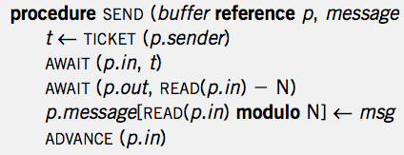
Multiple Senders and Single Receiver
No loop! Is it OK?

Slide 19
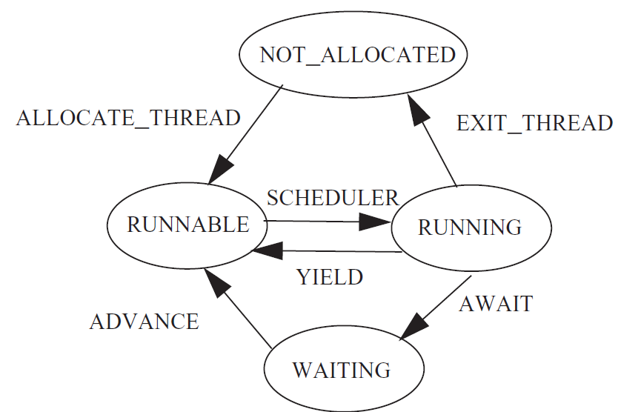
Thread State Diagram

Slide 20
OS Structure

Slide 21

Virtualization: C/S on a Single Machine
in order to enforce modularity + build an effective operating system
programs shouldn’t be able to refer to
(and corrupt) each others’ memory
Virtual memory
programs should be able to
communicate
Bounded buffer (virtualize communication links)
programs should be able to share a
CPU without one program halting the
progress of the other
Thread for multiplexing the processor
today: running multiple OSes at once
(and dealing with kernel bugs)

Slide 22
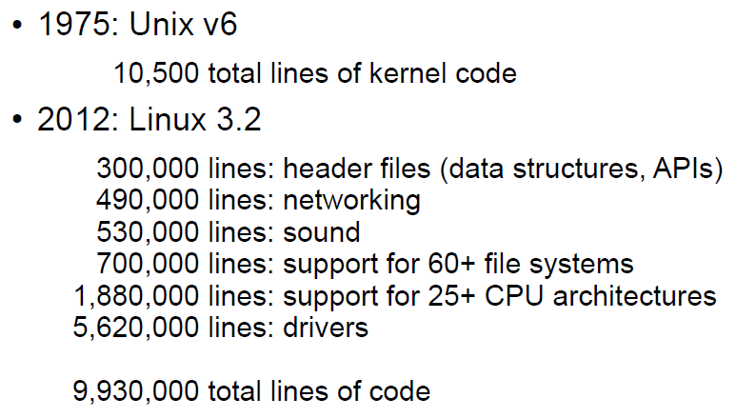
Kernel Complexity

Slide 23
Monolithic Kernel
Linux is Monolithic
No enforced modularity (e.g., Linux)
A bug in the kernel can affect entire system
How can we deal with the complexity of such systems?
One result of all this complexity: bugs!

Slide 24
Linux Fails
A kernel bug can
Cause the whole Linux system to fail
Is it a good thing that Linux lasted this long?
Problems can be hard to detect, even if they may still do damage
E.g., maybe some files are corrupted, but system does not crash
Worse: adversary can exploit a bug to gain unauthorized access

Slide 25

Linux Bugs
Source: Bugzilla.kernel.com, count of all bugs currently marked NEW, ASSIGNED, REOPENED, RESOLVED, VERIFIED, or CLOSED, by creation data

Slide 26
Types of OS Structure

Slide 27
Monolithic Kernel
The kernel is trusted for hardware management
Memory manager
Devices manager, e.g., clock, display, disk
Modules that manage the hardware are part of the kernel
The window manager, network manager , file manager
Monolithic kernel
Most of the operating system runs in kernel mode

Slide 28
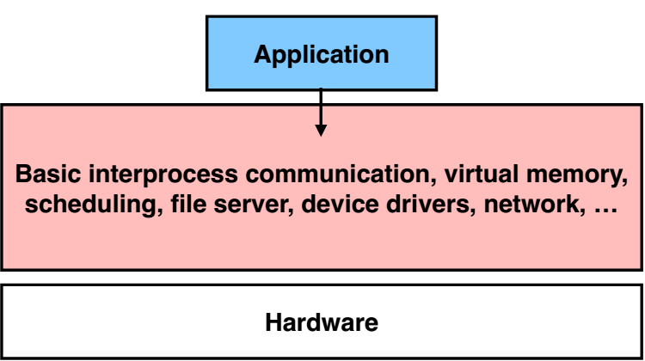
Monolithic Kernel: No Enforced Modularity within the Kernel

Slide 29
Monolithic Kernel
Pros
Relatively few crossings
Shared kernel address space
Performance
Cons
Flexibility
Stability
Experimentation

Slide 30
Microkernel
It is preferred to keep the kernel small
Reduce the number of bugs
Restrict errors in the module
E.g., the file manager module error may overwrite kernel data structures unrelated to the file system
Causing unrelated parts of the kernel to fail

Slide 31
Microkernel
System modules run in user mode
Each module is restricted in its own domain
Microkernel itself implements a minimal set of abstractions
Domains to contain modules
Threads to run programs
Virtual communication links

Slide 32
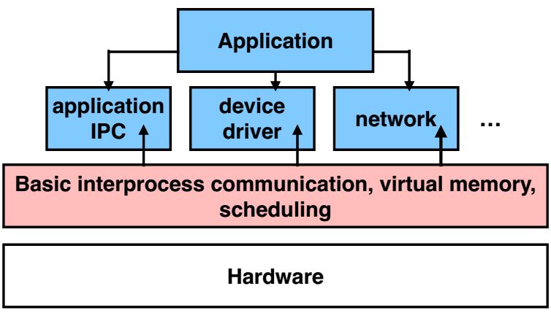
Microkernel: Enforce Modularity by Putting Subsystems in User Space

Slide 33
Microkernel
Pros
Easier to develop services
Fault isolation
Customization
Smaller kernel => easier to optimize
Cons
Lots of boundary crossings
Relatively poor performance

Slide 34
Microkernel VS. Monolithic Kernel
Few microkernel OS
Mach, L4
Most widely-used operating systems have a mostly monolithic kernel
the GNU/Linux operating system
the file and the network service run in kernel mode
the X Window system runs in user mode

Slide 35
Microkernel VS. Monolithic Kernel
The system is unusable if a critical service fails
No matter in user mode or kernel mode
Some services are shared among many modules
It’s easier to implement these services as part of the kernel program, which is already shared among all modules
The performance of some services is critical
E.g., the overhead of SEND and RECEIVE supervisor calls may be too large

Slide 36
Microkernel VS. Monolithic Kernel
Monolithic systems can enjoy the ease of debugging of microkernel systems
good kernel debugging tools
It may be difficult to reorganize existing kernel programs
There is little incentive to change a kernel program that already works
If the system works and most of the errors have been eradicated
the debugging advantage of microkernel begins to evaporate
the cost of SEND and RECEIVE supervisor calls begins to dominate

Slide 37
Microkernel VS. Monolithic Kernel
How to choose
a working system and a better designed, but new system
don’t switch over to the new system unless it is much better
The overhead of switching
learning the new design
re-engineering the old system to use the new design
rediscovering undocumented assumptions
discovering unrealized assumptions

Slide 38
Microkernel VS. Monolithic Kernel
The uncertainty of the gain of switching
The claims about the better design are speculative
There is little experimental evidence that
microkernel-based systems are more robust than existing monolithic kernels

Slide 39
Another Solution
Problem:
Deal with Linux kernel bugs without redesigning Linux from scratch
One idea: run different programs on different computers
Each computer has its own Linux kernel; if one crashes, others not affected
Strong isolation (all interactions are client-server), but often impractical
Can't afford so many physical computers: hardware cost, power, space, ..

Slide 40
Virtual Machine

Slide 41
Run multiple Linux on a Single Computer?
Virtualization + Abstractions
New constraint: compatibility, because we want to run existing Linux kernel
Linux kernel written to run on regular hardware
No abstractions, pure virtualization
Approach is called "virtual machines" (VM):
Each virtual machine is often called a guest
The equivalent of a kernel is called a "virtual machine monitor" (VMM)
The VMM is often called the host

Slide 42
Why Virtual Machine?
Consolidation
Run several different OS on a single machine
Isolation
Keep the VMs separated as error container
Fault tolerant
Maintenance
Easy to deploy, backup, clone, migrate
Security
VM introspection
Antivirus out of the OS

Slide 43
What are the Differences between OS & VMM?
Similarities
Multiplex hardware
Higher privilege
Differences
Different abstraction
VMM schedules VMs, OS schedules processes
App-1
App-2
App-3
VM-1
VM-2
VM-3
OS
VMM
CPU
Mem
Device
CPU
Mem
Device

Slide 44
Virtualization
CPU virtualization
Enable each guest VM has its own kernel and user modes
Keep isolation between guest’s kernel and user modes
Memory virtualization
Enable each guest VM has its own virtual MMU
Keep isolation between guest VMs
I/O virtualization
Enable each guest VM has its own virtual devices

